Slide 1
Deep Dive on Augmented Close & Consolidation

Slide 2
Close & Consolidation
Observed Trends: The Financial Close has expanded significantly in terms of what is now required for Finance professionals to close and report on, including operational details beyond the traditional general ledger aimed to an increased number of stakeholders than before
Common Challenges: Finance needs to break the status-quo and embrace the growing scope of the Close process resulting in an escalating amount of different data points from multiple source systems typically not familiar to the Finance department
Perceived Risks: data accuracy & reconciliation, mandatory compliance, overall increase of the close time, lack of capabilities in legacy solutions
MARKET
INSIGHTS
Notes:
What we are seeing in the market today from customers need to streamline their close and consoldation processes is that the landscape of financial close and consolidation is evolving rapidly, demanding more from finance professionals than ever before.
What was once a process focused solely on the general ledger has now expanded to include operational details and insights for a growing number of stakeholders. Finance teams are no longer just closing the books—they’re being asked to comply with additional regulations, report on sustainability data and process mich higher volumes of non-financial data.
This evolution comes with significant challenges. Teams must navigate increasingly complex processes, pulling together data from multiple, often unfamiliar systems. Breaking free from the status quo means adopting new tools and approaches to manage larger data volumes, ensure collaboration, and streamline workflows effectively.
With these challenges come risks: data accuracy and reconciliation issues across many systems that now Finance needs to interface with, compliance pressures, lengthened close times, and the limitations of legacy systems. These risks not only slow the process but also undermine the ability to provide timely and accurate insights.
With CCH Tagetik Augmented Close, we aim to redefine the traditional financial close process by extending its scope to address lateral process advancements and meet heightened compliance requirements. Our solution goes beyond simply closing the books, empowering finance teams to streamline analytical workflows, integrate operational data, and ensure accuracy while adapting to the increasing demands of modern financial reporting and governance – NEXT SLIDE

Slide 3
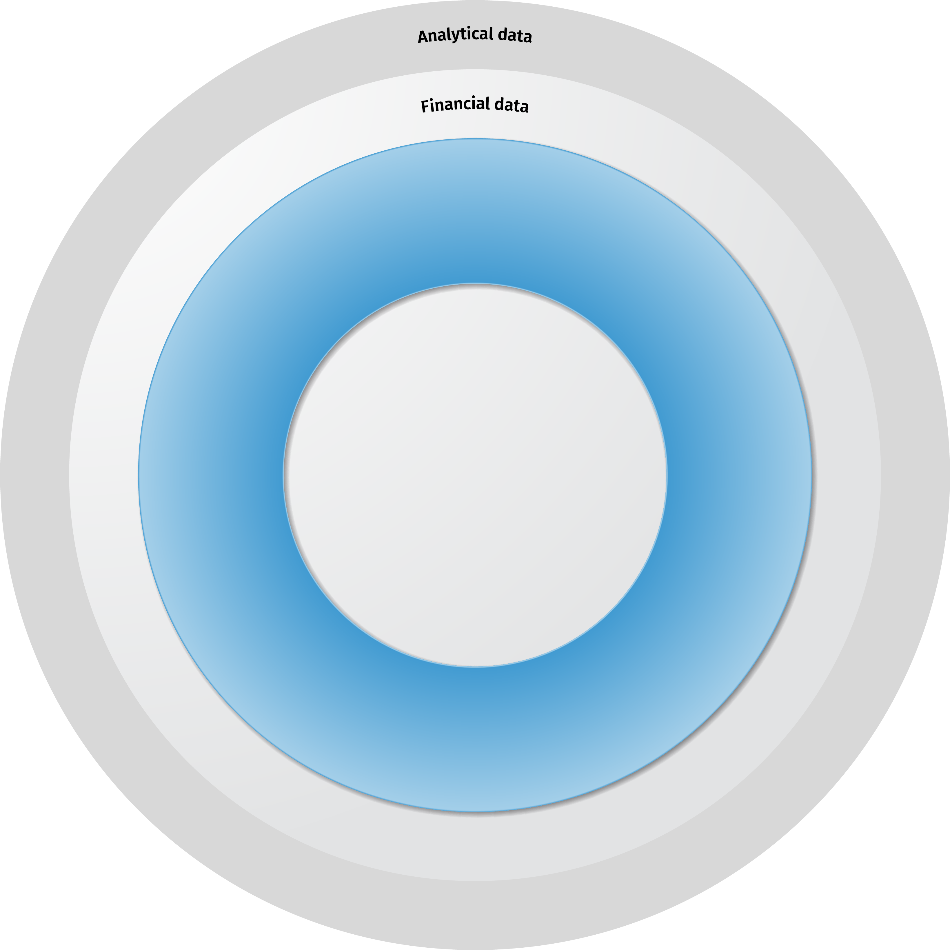
Traditional Financial Close & Consolidation
Focused on aggregated trial balance data, this process involves gathering financial information—primarily from the general ledger system—and making necessary adjustments to generate traditional consolidated financial statements.
Reporting and analytics, dashboard, variance analysis, scorecard, performance reporting, annual report
Local
Close
Financial
Consolidation
CCH® Tagetik Financial Close & Consolidation
Disclosure
And iXBRL
Financial
Reporting
Regulatory
Reporting
Traditional close processes
Notes:
Traditionally, the financial close and consolidation process has focused on the aggregated trial balance level, summarizing data directly from the general ledger (GL). The process typically begins with entity-level closing, followed by aggregation and elimination of entries at the consolidated level. Its primary objective has been to produce consolidated financial statements—such as income statements, balance sheets, and cash flow statements—at the GL account level to meet statutory reporting requirements.
While this approach has been effective for compliance purposes, it is increasingly outdated. It often lacks the depth and flexibility needed for detailed analysis or broader reporting, especially in today's environment of heightened regulations and growing stakeholder demands for operational-level details.
With the CCH Tagetik Augmented Close we redefine the traditional financial close and consolidation process by expanding its scope beyond just trial balance and financial statement-focused tasks – MEXT SLIDE

Slide 4
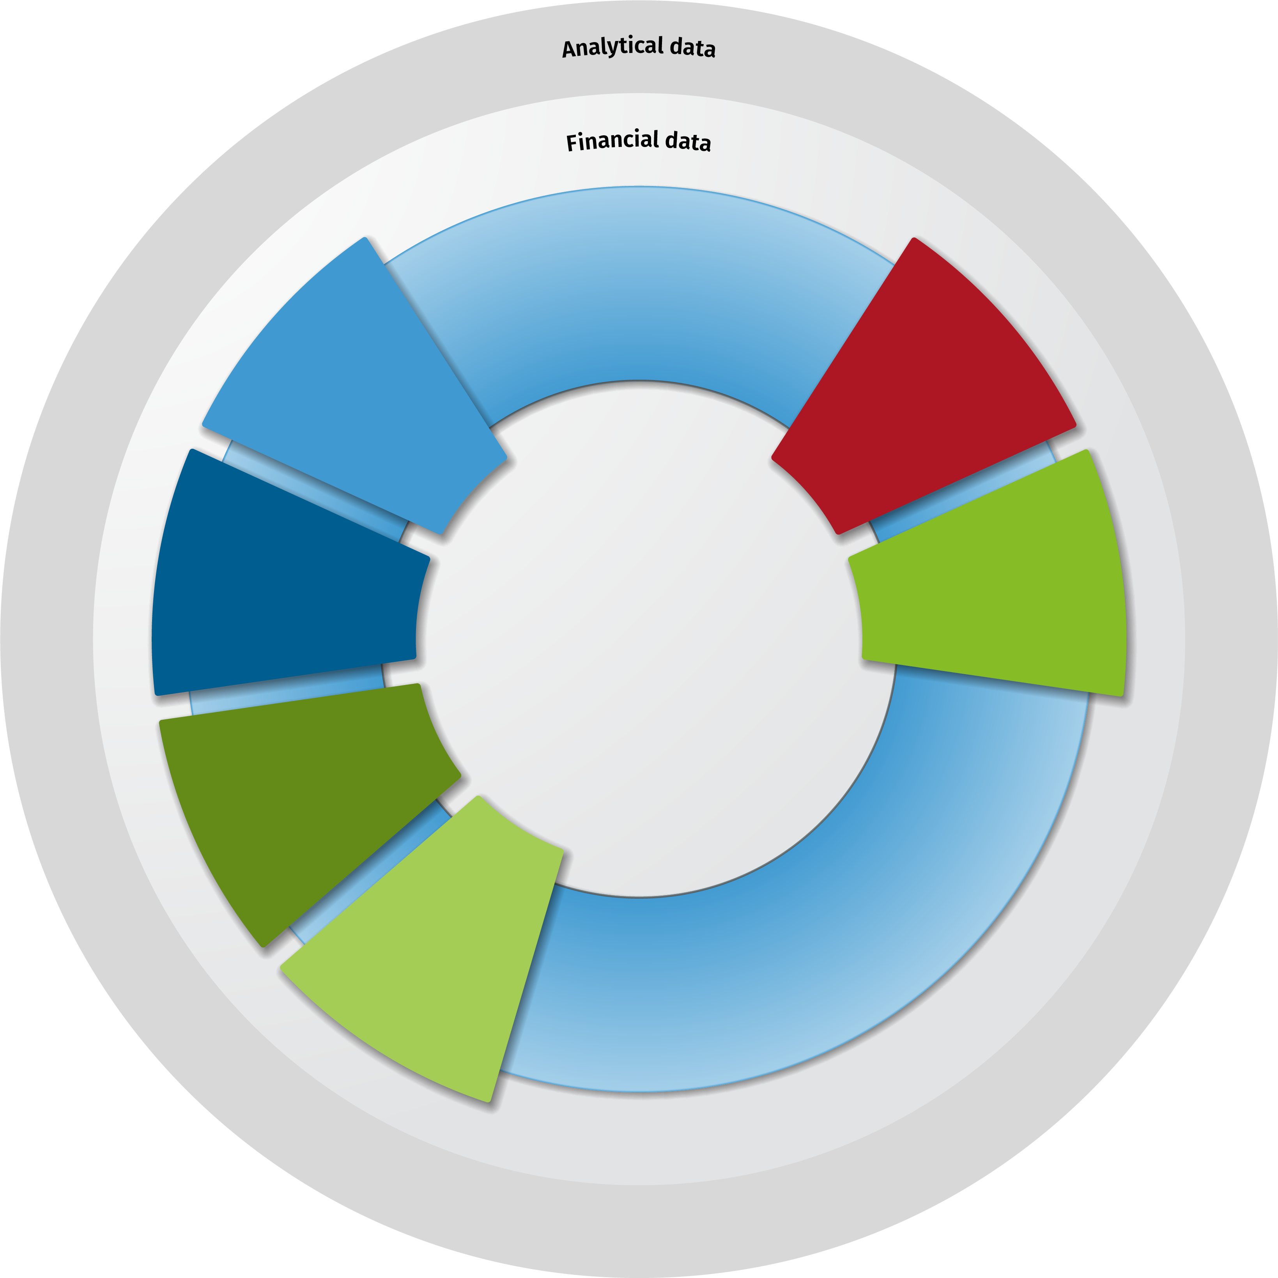
CCH Tagetik Augmented Close
Extending beyond the traditional Trial-balance and financial statement- bound close process to cover lateral operational adjacencies through embedded financial & artificial intelligence for expanded reporting, compliance & insights
Financial statement reporting, variance analysis, performance reporting, annual report, 10Q/10K
Analytic Information Hub
data transformation, modeling,
and extensibility
Group
Consolidation
Local
Close
Account
Reconciliation
Corporate
tax
Transaction
Matching
CCH® Tagetik Augmented Close & Consolidation
ESG &
Sustainability
Disclosure
And iXBRL
Lease
Accounting
Financial
Reporting
Insurance
Accounting
Management
Reporting
Traditional close processes
Extended close processes
Notes:
With CCH Tagetik, we go beyond the traditional trial balance and financial statement-focused close process by extending to lateral operational adjacencies powered by embedded financial intelligence and artificial intelligence. This approach enables organizations to achieve expanded reporting, enhanced compliance, and deeper insights to tackle today’s increasingly complex financial and operational demands.
Our augmented close and consolidation workflow includes:
Core Activities for Traditional Financial Consolidation: We cover the usual Financial close and consolidation tasks such as journal entry management, currency conversion, multi-GAAP reporting, intercompany (IC) management, and eliminations, ensuring a robust and accurate consolidation foundation.
Addressing Additional Regulatory Compliance: New regulations, such as lease accounting and the global minimum tax, require organizations to extend beyond standard financial statements. CCH Tagetik integrates these complex compliance requirements seamlessly into the close process, reducing manual effort while ensuring accuracy and adherence.
Incorporating Analytical and Non-Financial Details: To meet the demand for detailed insights, tasks like account reconciliation and transaction matching require processing massive data volumes from diverse source systems. CCH Tagetik automates these high-volume tasks, delivering granular insights efficiently.
Supporting ESG and Sustainability Reporting: The rising focus on sustainability reporting necessitates integrating both operational and non-financial data into the financial close process. CCH Tagetik’s flexibility and scalability enable organizations to meet these evolving demands and provide comprehensive ESG disclosures.
By embedding AI-powered automation, CCH Tagetik handles the large volumes of data that modern consolidation implies, enhancing accuracy and streamlining validation processes. This empowers organizations to stay compliant, provide richer insights, and deliver a complete and timely view of both financial and operational performance, meeting the growing challenges of regulatory

Slide 5
CCH Tagetik Close & Consol Differentiators
1
Consolidation at the lowest level
2
Cash Flow & Segment Reporting
3
Financial Intelligence
With no need for "elim" entities or "period 13" dimensions, CCH Tagetik tracks all balances, movements, journals and eliminations at the lowest level of granularity.
This ensures maximum level of data lineage and transparacy all the way from the GL upload to the disclosure of the consolidated data.
CCH Tagetik has advance capabilities to track the activity of any BS account automatically and/or through manual/automatic pull from source systems allowing for 100% Cash Flow Automation and production of all necessary Continuity Schedules with full traceability of the historical activity.
Unlike other solutions that use pre-packaged scripts, CCH Tagetik acts like a CPA for your consolidation needs. It knows what type of FX rate to use for BS versus PL accounts, it knows how to calculate NCI based on the ownership structure and it knows how to perform even the most complicated eliminations with the need of any script or rule.
Extending Beyond traditional Financial Consolidation
Notes:
It is clear at this point that the main CCH Tagetik differentiator when it comes to Financial Close and Consolidation is our ability to extend beyond the traditional Trial-balance &financial statement- bound close process to cover lateral operational adjacencies through embedded financial & artificial intelligence (think of Account Rec, Lease Accounting, GMT, ESG, etc)
More specifically, CCH Tagetik's close and consolidation differs from other tools out there for the following aspects:
1. Consolidation at the Lowest Level
One of the key advantages of CCH Tagetik is its ability to consolidate at the most granular level, eliminating the need for ‘elim’ entities or artificial ‘period 13’ adjustments. Unlike other solutions that require workarounds (like fake entities, period 13, etc), CCH Tagetik automatically tracks all balances, movements, journals, and eliminations directly at the transactional level.
This ensures maximum data lineage and transparency, allowing finance teams to trace numbers all the way from the general ledger (GL) upload to final disclosure reporting. That level of visibility helps accelerate audits, improve compliance, and enhance confidence in financial reporting.
2. Cash Flow and Segment Reporting
CCH Tagetik offers out-of-the-box cash flow automation through its "Account Movement" functionality, enabling users to track activity for each balance sheet account between periods. Unlike a simple calculation of Ending Balance - Beginning Balance = Movement, CCH Tagetik provides a detailed breakdown of each movement, including additions, disposals, FX rate differences, mergers, and more. This granular approach automatically feeds the Cash Flow Statement, ensuring every transaction is classified correctly, reducing reconciliation efforts, and providing a fully auditable cash flow automation process.
3. Financial Intelligence
Where other solutions rely on pre-packaged scripts or custom configurations, CCH Tagetik acts like a CPA built into your consolidation process. It understands financial logic, including:
The appropriate FX rate type to use for balance sheet vs. P&L accounts
Automatic calculation of non-controlling interest (NCI) based on ownership structures
The ability to perform complex eliminations without needing scripting
This level of intelligence significantly reduces the need for manual intervention or complex rule-building, ensuring faster, more accurate consolidation cycles and better audit defense.

Slide 6
CCH Tagetik Augmented Close
Solution Benefits
Data Accuracy
one-stop-shop for all your present & future closing needs leveraging AI to reconcile financial and operational data across multiple systems
Faster time to close
demonstrated reduction in close time by minimizing errors while automating high-volume tasks.
Compliance
Build audit defense through built-in compliance by aligning with local and global regulatory standards
+86%
error reduction
-4.3
close time (days)
100%
compliance
Notes:
With the CCH Tagetik Augmented close our customers experience:
Significant Reduction in Manual Errors: By using CCH Tagetik as your all-in-one solution for financial close and consolidation, there’s no need for manual data transfers or reconciliations across multiple systems, inherently improving data accuracy. Additionally, our AI-powered validation services further enhance data accuracy, ensuring reliable and error-free results.
Faster Close Times: With centralized data management for both traditional financial consolidation and operational needs, combined with embedded artificial and financial intelligence, CCH Tagetik automates high-volume tasks and streamlines workflows. This efficiency allows users to reduce close times by up to 30%, enabling faster and more efficient processes.
Stronger Audit Defense: CCH Tagetik provides built-in compliance with global and local regulatory standards, ensuring organizations meet new and evolving requirements seamlessly. This standardized and transparent approach strengthens audit readiness, reducing risk and enhancing confidence in financial reporting.

Slide 7
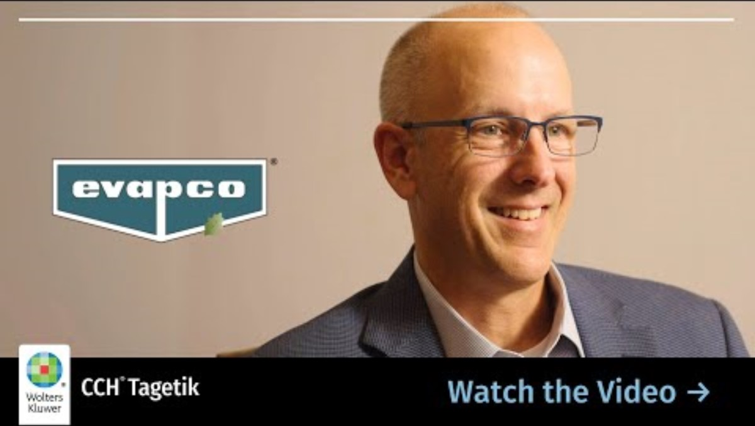
Customer Testimonial
“Down from 6 weeks to 2 weeks with the year end close”
https://www.youtube.com/watch?v=wtOJsWA5lB0

Slide 8



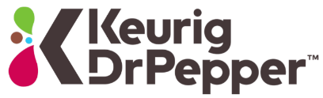
Keurig Dr. Pepper automates complex cash flow reporting
CCH® Tagetik processes: Consolidation and Financial Reporting
CHALLENGES
KEY DECISION FACTORS
ACHIEVEMENTS
Post Merger of the Keurig and Dr Pepper Snapple companies – both companies utilized the same software solution with vastly different database design and data granularity. A unified enterprise solution was needed to truly merge the companies and provide consistent financial view of the new company.
Prior solutions were on-premise – lack of regular enhancements, costly maintenance, upgrades and technical support demanded need for a full featured Cloud based solution.
Ease of Reporting / Excel Interface – dynamic reporting reduces maintenance. Cash Flow and Intercompany reporting.
Financial Intelligence - no custom rules required and configurable by business users. Maintenance is simplified and cost savings.
Reporting Details - drill through details can be loaded and available from reporting without performance affect on consolidation processing time.
Flexible Data Loading/Automation – elimination of interim software interfaces to source and deliver
Cash Flow Automation- collection and automation of Balance Sheet movements to automate roll forward scheduled and cash flow reporting
Flexible Reporting – Financial and Segment for the Hot and Cold Divisions reporting now available with flexibility to accommodate fluid requirements as new company analysis definitions evolve.
Complex Financial Reporting – complex reporting views (previously manually generated) are easily accomplished and maintained: ie: GAAP, Mgmt to GAAP walk, Guarantor, IFRS.
Fully Automated Data Loads – automated, hourly data loads from all GLs fed by Data Lake.
Unified Solution for all post merger divisions
Notes:
SUMMARY:
Keurig Dr Pepper replaced their legacy HFM system with CCH Tagetik to unify financial data across their Hot and Cold divisions. The platform's automation capabilities, particularly in cash flow reporting through automatic movements and roll-forward schedules, significantly reduced manual effort and improved data accuracy.
DETAIL:
Keurig Dr Pepper (KDP) replaced their legacy HFM system with CCH Tagetik, selecting it as the ideal platform to manage their consolidation and financial reporting needs.
The goal was to not only integrate financial data across the company’s Hot (beverage systems) and Cold (packaged beverages) divisions but also to automate and streamline critical processes such as cash flow reporting.
CCH Tagetik's unique capabilities proved instrumental in delivering these objectives.
With its intuitive, Excel-like interface and embedded financial intelligence, the platform enabled seamless integration obetween the two divisions. This provided KDP with a unified view of their consolidated financials, ensuring data accuracy and alignment across the organization.
A standout achievement of the project was the automation of cash flow reporting, which had previously required extensive manual effort. CCH Tagetik introduced automatic cash flow movements and roll-forward schedules, eliminating the need for manual adjustments and significantly reducing the risk of errors. This automation not only improved efficiency but also provided real-time visibility into cash flow, enabling faster and more accurate analysis for strategic decision-making.
Additionally, the solution streamlined reporting across all divisions, supporting complex requirements such as GAAP and IFRS compliance, statutory reporting, and ad hoc analysis. By unifying data and automating key processes, KDP gained a future-proof platform that could scale with the business and adapt to evolving regulatory demands.

Slide 9

CDPQ consolidates 230 BUs and NAV daily
CCH® Tagetik processes: Consolidation, Financial Close and Collaborative Office
CHALLENGES
KEY DECISION FACTORS
ACHIEVEMENTS
Significant coordination and manual tasks
Multiple data sources, non-integrated
Two sets of reference (Accounting & Investment)
Mono entity and currency limitation
Important efforts spent at month end
Numerous in house apps
Embrace globalization activities, and support increase complexity
Delivers complex business automation
Mature product and functionalities
Integrated powerful reporting
Application adapted for the business users
Cloud security and technology aligned with standards
Delivers complex business automation
Ability to understand customer’s business model
Daily consolidation of ~230 business units and NAV
Automation : 50% faster, 200 hours reduction
One single source of truth
One unified language and simplified reconciliation
Multi entity and enriched currency management
Effort spread through the month and toward analytics
40 apps eliminated
Support investment through subsidiaries (>40%)

Slide 10

Evapco unifies processes to gain confidence and achieve compliance
CCH® Tagetik processes: Account Reconciliation, Consolidation, Financial Reporting, Forecasting, Lease Accounting (IFRS 16 & ASC 842)
CHALLENGES
KEY DECISION FACTORS
ACHIEVEMENTS
Excel used for Consolidation, challenging to perform Account Reconciliation
Desire to be prepared for new Lease Accounting rules
Inefficient close process – closing only on an annual basis
All in One Solution – Consolidation, Account Reconciliation, Financial Reporting, Leasing together– local GAAP, IFRS adjustments thru to full consolidation
Comprehensive solution – Multi-GAAP, IFRS, I/C eliminations, currency translation for 30 companies using 12 currencies
Timely and robust reporting and ability for drill-down to details
On the cloud – for global accessibility, reduced IT needs and easy quarterly updates
One single solution and source of the truth
Improved data accuracy, quality and traceability resulting in better confidence
Faster cycles with monthly close (6 days) instead of annual close (4 weeks duration)
Time for analysis
Flexibility with ad-hoc reporting and drill-down to details
Achieved compliance for Lease Accounting
“Controllers will review accounts on a more timely basis. Significant accounts should be reviewed before submitting to the corporate office….giving us greater confidence on the close and making sure it’s more accurate.”
Jeffrey Finch, CFO

Slide 11
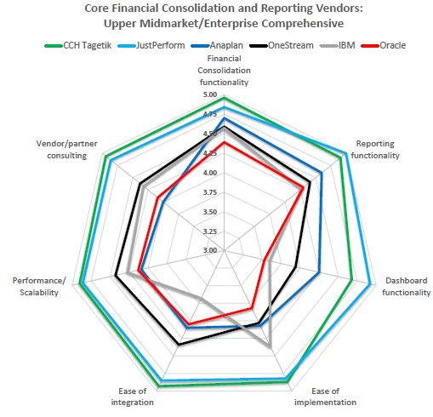
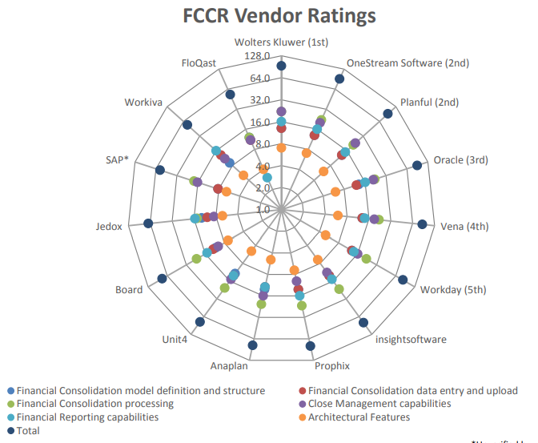
Analyst Validation & Leadership
BPM Partners 2025 Buyers’ Guide for Financial Close, Consolidation and Reporting Solutions
Dresner Advisory, 2024 Wisdom of Crowds® Financial Consolidation, Close Management, and Financial Reporting Market Study

Slide 12
Common Questions & Competitive FUD
Lack of SmartView like functionality
CCH Tagetik offers similar functionality to SmartView called SmartInsights, SI is a web-based self-service reporting tool for ad hoc reporting and on the fly analysis. Tagetik SmartInsight gives you the power to slice & dice, and drill down into large volumes of data on the fly using a rapid-fire processing engine through a drag and drop approach..
Pre-built financial intelligence in CCH Tagetik consolidation limits customization
Relying heavily on pre-built intelligence might raise concerns for customers presenting unusual requirements. While we prioritize leveraging pre-built functionality , CCH Tagetik offers a fully open architecture, enabling users to create custom rules and calculations as needed to meet unique business requirements
Do you support USGAAP?
Yes, CCH Tagetik fully supports US GAAP and International Accounting Standards. Public US based organizations such as Keurig Dr. Pepper, The Rockefeller Foundations, TPG, Worthington Industries and many others use our solution to close their books and file to the SEC.
Is CCH Tagetik SOX compliant?
Yes, CCH Tagetik is fully SOX compliant and used by US-based public organizations such as Keurig Dr. Pepper, TPG, Worthington Industries and others to consolidate their results for SEC filing purposes. We provide a framework of features and capabilities such as Advanced Audit Trail, Role-based Security for segregation of duties, internal controls and workflow management, etc to help organizations maintain strong financial controls and governance

Slide 13
Consolidation Strengths & Weaknesses
Strengths | Weaknesses
No code approach – truly built-in financial intelligence | SmartView-like functionality
Movement Tracking for BS Account Activity | Journal Entry Workflow (posting/non posting)
Cash Flow Reporting Automation | Close Task Management
Segment Analysis and Reporting
Performance in Consolidation Data Processing
Elimination at the lowest member level instead of fist common parent

Slide 14
THANK YOU

